Slide 1

Enhancing Real Estate Business Through Data-Driven Analysis
Strategic insights for maximizing profitability and market expansion
MANISHA PAL
ROLL NO. 23F1001570

Slide 2
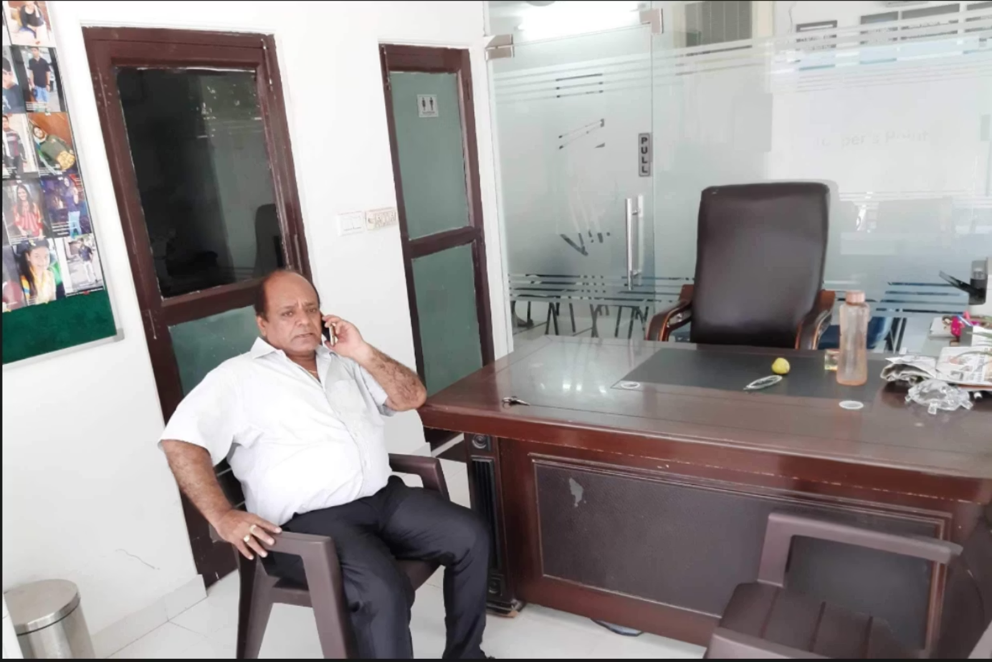
About the Project
Narang Associates
Four years of comprehensive real estate data systematically collected, processed, and analyzed to unlock actionable business insights.
Multi-year transactional data analysis
Customer demographics and preferences
Competitive market landscape assessment
Location-based performance metrics
Challenge 1
Challenge 2
Challenge 3
Limited market reach and stagnant customer growth
Inability to leverage data-driven insights due to lack of analysis
Geographic constraints preventing business expansion

Slide 3




Problem-Solving Approach
Expand Customer Base
Implement digital marketing and strategic partnerships to reach broader audiences
Enable Data-Driven Decisions
Deploy comprehensive analysis tools to transform raw data into strategic insights
Geographic Expansion
Identify high-potential markets beyond current operational boundaries

Slide 4
Analysis Process
01
02
Data Collection
Data Cleaning
Three years of data gathered through owner interviews, business records, and Google Maps analysis
Unstructured data organized using Excel for clarity and accuracy
03
04
Descriptive Statistics
Competitive Analysis
Key metrics summarized to identify performance patterns
Market saturation assessed through competitor density mapping
05
06
Trend Analysis
Visualization
Income trends and customer preferences analyzed by location
Charts created to represent trends and demographics visually
Main Dataset
Competitor Analysis
Deals by Location
Customer location preferences, rental/sale choices, commissions, expenses
Number of competitors by operational area
Transaction volume tracked across three years

Slide 5
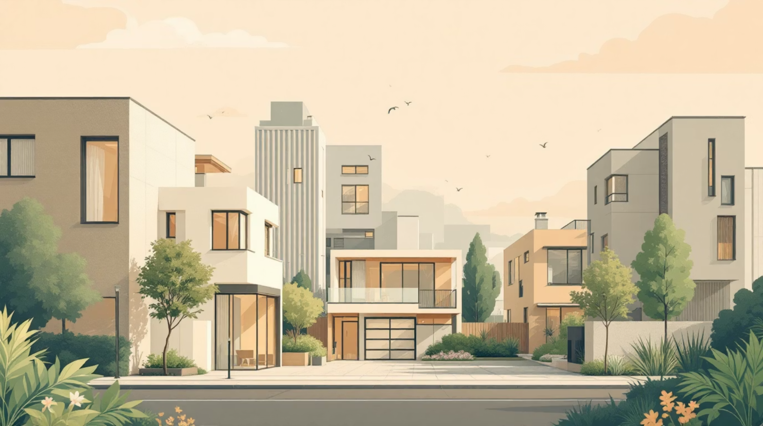
Key Findings: Top Locations
Indira Nagar Leads
Highest deal frequency and commission earnings identified through comprehensive analysis
Maximum transaction volume
Strongest revenue generation
Consistent performance patterns
Location analysis filtered based on deal count and commission earned to identify optimal markets for strategic focus and resource allocation.

Slide 6
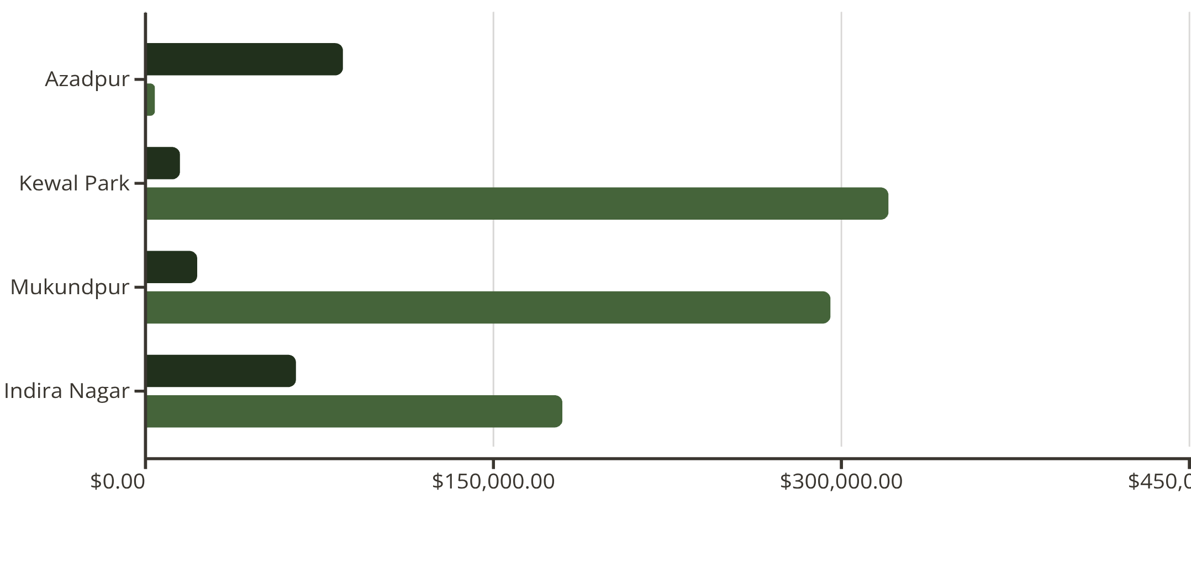
Revenue Patterns by Location
Specialization Opportunities
Azadpur: Pure rental market generating consistent rental commissions
Kewal Park & Mukundpur: Sales-dominated markets with highest transaction values
Strategic Insight: Tailor services to match location-specific demand patterns
Rental Commission
Sales Commission

Slide 7
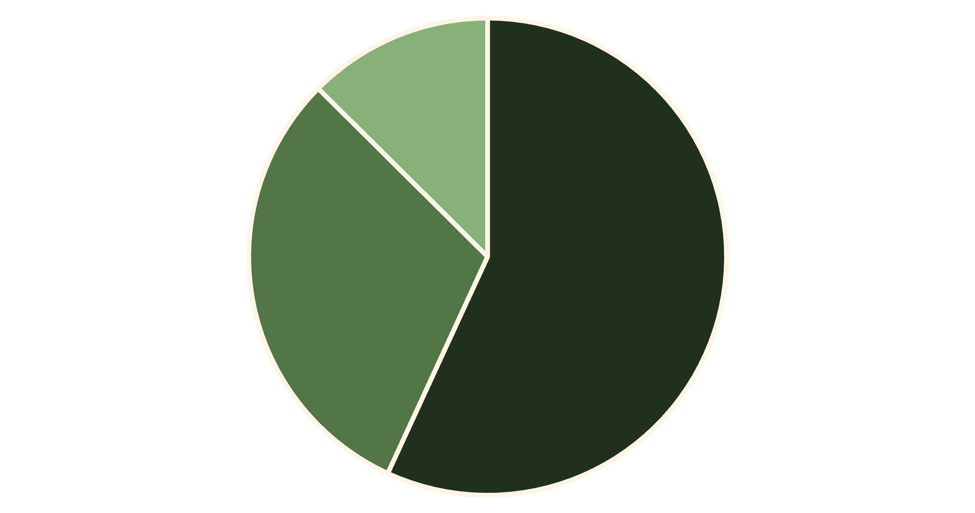
Property Type Demand Analysis
Market Preferences
Plot demand significantly lower than flats and commercial properties
Aadarsh Nagar & Indira Nagar: High residential flat demand
Azadpur & Model Town: Strong commercial property interest
Recommendation: Focus inventory on flats and commercial spaces
Flats
Shops
Plots

Slide 8
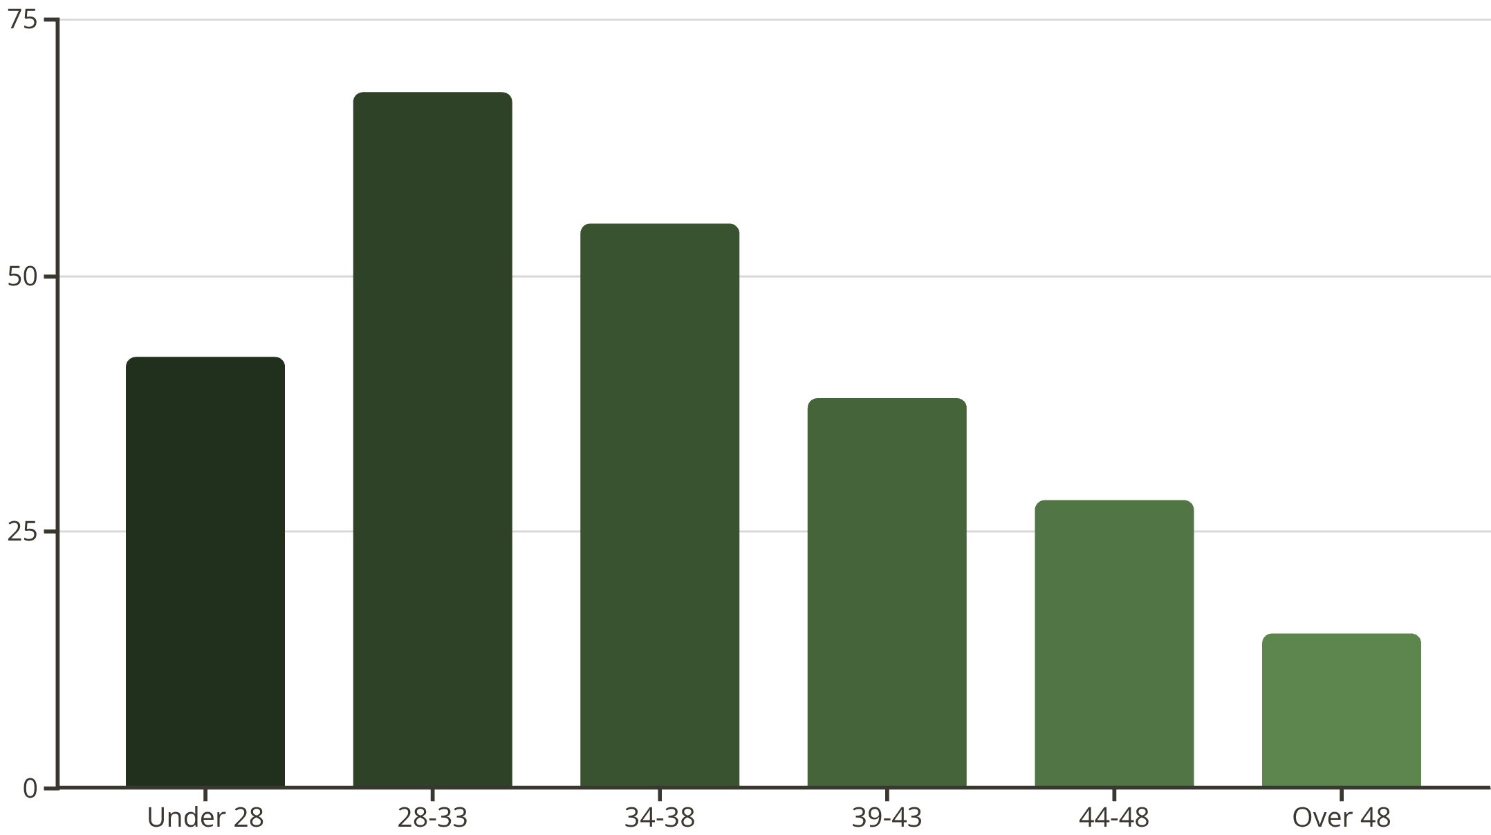
Customer Demographics: Age Insights
Target Demographic Identified
Prime Market: 28-48 years, peak under 33
Marketing Strategy: Focus on young professionals and growing families
Opportunity: Investment properties for older segments remain viable secondary market

Slide 9


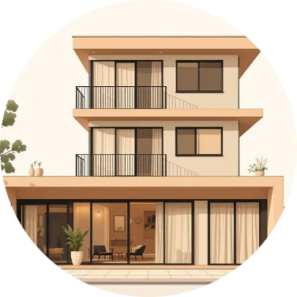



Strategic Recommendations
Location Focus
Premium Market Strategy
Rental Growth
Balanced Property Mix
Boost marketing in Indira Nagar and Majlis Park with client incentives and personalized outreach
Target high-value properties in Adarsh Nagar and Model Town with luxury showcases
Establish rental expertise in Model Town and Azadpur through targeted marketing
Focus on rentals in high-demand areas, prioritize premium properties in top sales regions
Strategic Partnerships
Digital Marketing
Collaborate with developers for exclusive property rights and financing options
Leverage Google Ads, SEO, referral programs, virtual tours, and influencer marketing

Slide 10


Expansion & Competitive Strategy
Geographic Expansion
Premium Projects
Target emerging high-growth areas like Dwarka, Noida Extension, and South Delhi for early market advantage
Partner with builders on luxury developments to attract affluent clients and boost commissions
Agent Collaboration
Client Retention
Share listings and clients with other agents to reduce competition and expand market reach
Implement loyalty programs and value-added services to enhance retention and repeat business
Unique Selling Proposition
Pre-Construction Deals
Secure exclusive listings and offer personalized, client-centric services for differentiation
Offer early-stage property opportunities to attract investors and generate upfront revenue
Key Takeaway: Strategic expansion combined with competitive differentiation creates sustainable growth pathways for Narang Associates

